Slide 2
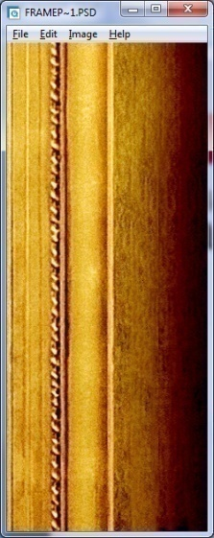
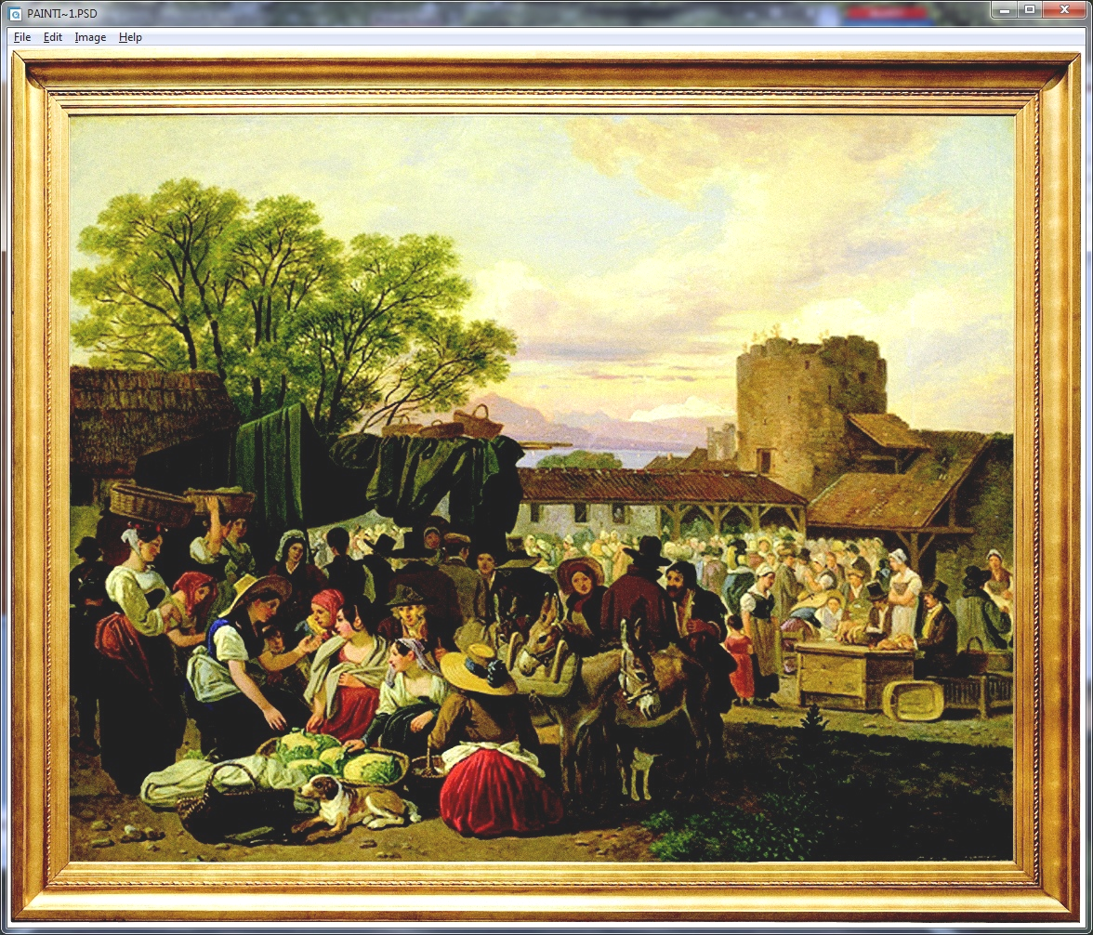
CHAPTER - 2
Principles of
MICROeconomics
(HSS – 1021)
Thinking Like an Economist
N. Gregory Mankiw

Slide 3
Thinking Like an Economist
Economics trains you to. . . .
  Think in terms of alternatives.
  Evaluate the cost of individual and social choices.
  Examine and understand how certain events and issues are related.
Notes:
2

Slide 4
Economic Models
A model is a simplified abstraction of reality or simplified representation of a real situation that is used to better understand real-life situations.
Economists use models to simplify reality in order to improve our understanding of the world
Two of the most basic economic models include:
  The Circular Flow Diagram
  The Production Possibilities Frontier

Slide 5
Our First Model: The Circular-Flow Diagram
The circular-flow diagram is a visual model of the economy that shows how Rupees flow through markets among households and firms.
Two types of “actors”:
  households
  firms
Two markets:
  the market for goods and services
  the market for “factors of production”
Notes:
6

Slide 6

The Circular Flow
Revenue
MARKETS
Spending
FOR
GOODS AND SERVICES
Firms sell
Goods and
Goods
Households buy
services
and services
bought
sold
FIRMS
HOUSEHOLDS
Produce and sell
Buy and consume
goods and services
goods and services
Hire and use factors
Own and sell factors
of production
of production
Labor, land,
Factors of
and capital
production
MARKETS
FOR
FACTORS OF PRODUCTION
Households sell
Income
Wages, rent,
Firms buy
interest and profit
= Flow of inputs
and outputs
= Flow of dollars
Copyright © 2004 South-Western

Slide 7
The Circular Flow – Active Learning
Imagine a hypothetical economy where there is one firm, i.e., Swarna Rice and household. Swarna Rice hired 20 labourers at the prevailing wage rate of Rs.200 per day, paid a rent of Rs.1,40,000 per annum and borrowed Rs. 20 lakh at an interest rate of 10% per annum. Swarna Rice produces 60,000 kg rice per annum and sells it at a price of Rs. 30 per kg.
Represent the interrelationship between the consuming and producing sector of the above hypothetical economy through circular flow diagram.
How much revenue Swarna Rice is earning during the year?
How much income the household is earning during the year?
If Gross Domestic Product of the economy is defined as the sum of all factor payments during a year, estimate GDP for the hypothetical economy for a year.

Slide 8
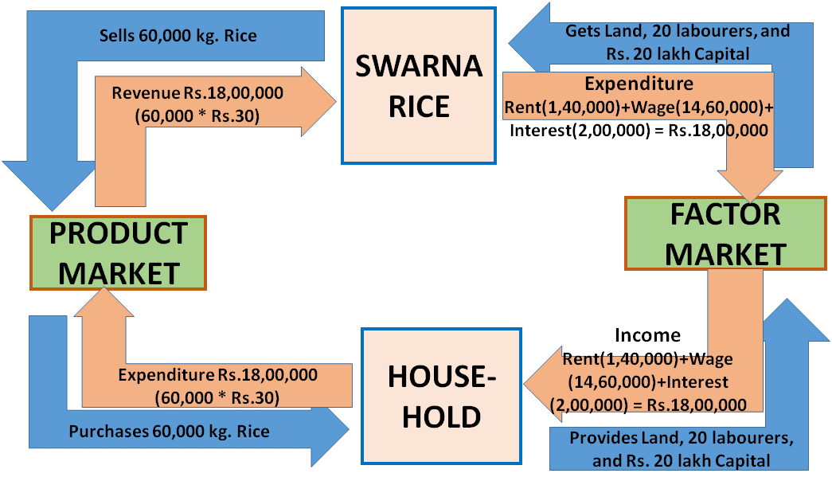
The Circular Flow - Answer
The interrelationship between the consuming and producing sector of the given hypothetical economy is represented through the circular flow diagram given below.

Slide 9
The Circular Flow - Answer
Swarna Rice is earning a revenue of Rs. 18,00,000 (60,000 * Rs. 30)
Sum of all factor incomes flowing from Swarna Rice to household in a year is the income of the household for that year. This includes Rent (Rs. 1,40,000), Wage (Rs. 200 * 20* 365 = Rs. 14,60,000) and Interest (10% of Rs. 20,00,000 = Rs. 2,00,000). Thus, the income of the household is Rs. 1,40,000 + Rs. 14,60,000 + Rs. 2,00,000 = Rs. 18,00,000
Sum of all factor payments, (rent + wage + interest) is Rs. 18,00,000. Therefore, the GDP for the hypothetical economy is Rs. 18,00,000.

Slide 10
Our Second Model:
Production Possibilities Curve (PPC)
OR
The Production Possibilities Frontier (PPF)
OR
Production Possibilities Graph (PPG)
The Production Possibilities Curve (PPC)
Using Economic Models…
  Step 1: Explain concept in words
  Step 2: Use numbers as examples
  Step 3: Generate graphs from numbers
  Step 4: Make generalizations using graph
Notes:
14

Slide 11
Our Second Model:
The Production Possibilities Frontier
The production possibilities frontier (PPF) is a graph that shows the combinations of output that the economy can possibly produce given the available factors of production (Resources) and the available production technology.
A production possibilities graph (PPG) is a model that shows alternative ways that an economy can use its scarce resources
This model graphically demonstrates trade-offs, opportunity costs, and efficiency.
Notes:
14

Slide 12
Our Second Model:
The Production Possibilities Frontier
4 Key Assumptions
  Only two goods can be produced
  Full employment of resources
  Fixed resources (Ceteris Paribus)
  Fixed technology
Example:
  Two goods: computers and car
  One resource: labor (measured in hours)
  Economy has 50,000 labor hours per month available for production.
  Producing one car requires 100 hours labor.
  Producing one computer requires 10 hours labor.
Notes:
14

Slide 13
PPF Example
0
Employment of
labor hours
Production
Cars
Computers
Cars
Computers
A
50,000
0
500
0
B
40,000
10,000
400
1,000
C
25,000
25,000
250
2,500
D
10,000
40,000
100
4,000
E
0
50,000
0
5,000
Each point represents a specific combination of goods that can be produced given full employment of resources (50,000 lab. Hours)

Slide 14
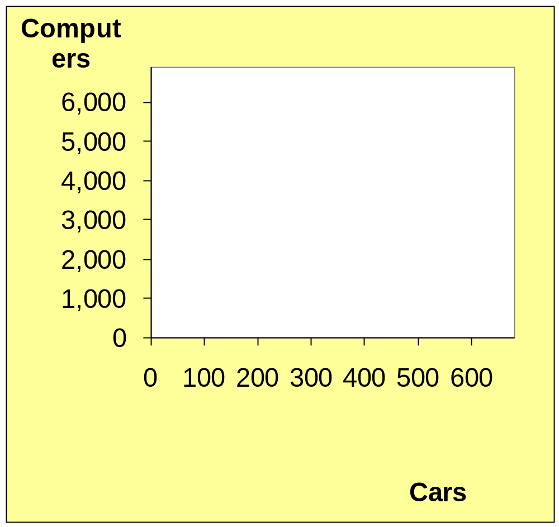
PPF Example
Point on graph | Production
 | Cars | Computers
A | 500 | 0
B | 400 | 1,000
C | 250 | 2,500
D | 100 | 4,000
E | 0 | 5,000
E
Impossible/ Unattainable
(given current resources)
D
G
F
C
Efficient and
Feasible
Inefficient/ Unemployment
Feasible
B
A

Slide 15
The PPF and Efficiency
Recall: An economy is efficient if there are no missed opportunities in production—there is no way to produce more of one good without producing less of other goods.
If the economy as a whole could not be able to produce more of any one good without producing less of something else—that is, if it is on its production possibility frontier—then we say that the economy is efficient in production.

Slide 16
The PPF and Efficiency
If, however, the economy could able to produce more of some things without producing less of others— which typically means that it could be able to produce more of everything, i.e., it is below its production possibility frontier—then it is inefficient in production.
For example, an economy in which large numbers of workers are involuntarily unemployed is clearly inefficient in production.

Slide 17
The PPF and Opportunity Cost
Recall: The opportunity cost of an item
is what must be given up to obtain that item.
Moving along a PPF involves shifting resources (e.g., labor) from the production of one good to the other.
Society faces a tradeoff: Getting more of one good requires sacrificing some of the other.
The slope of the PPF is explained by the opportunity cost per unit of one good in terms of the other.

Slide 18
The PPF and Opportunity Cost
Commodity Bundle | Production of |  | Additional unit of Car Produced | Opportunity Cost of Additional Unit of Car (No. of Computer Sacrificed) | Opportunity Cost of Car per unit
 | Car | Computer
A | 500 | 0 | 100 | 1000 | 1000/100=10
B | 400 | 1000 | 150 | 1500 | 1500/150=10
C | 250 | 2500 | 150 | 1500 | 1500/150=10
D | 100 | 4000 | 100 | 1000 | 1000/100=10
E | 0 | 5000 | - | - | -

Slide 19
The PPF and Opportunity Cost
Commodity Bundle | Production of |  | Additional unit of Computer Produced | Opportunity Cost Additional Unit of Computer (No. of Car Sacrificed) | Opportunity Cost per unit of Computer
 | Car | Computer
A | 500 | 0 | - | - | -
B | 400 | 1000 | 1000 | 100 | 100/1000=0.1
C | 250 | 2500 | 1500 | 150 | 150/1500=0.1
D | 100 | 4000 | 1500 | 150 | 150/1500=0.1
E | 0 | 5000 | 1000 | 100 | 100/1000=0.1

Slide 20
The PPF and Opportunity Cost
Commodity Bundle | Production of |  | Opportunity Cost of producing |  | Opportunity Cost per unit of
 | Car | Computer | Additional units of Car | Additional units of Computer | Car | Computer
A | 500 | 0 | 1000 | - | 10 | -
B | 400 | 1000 | 1500 | 100 | 10 | 0.1
C | 250 | 2500 | 1500 | 150 | 10 | 0.1
D | 100 | 4000 | 1000 | 150 | 10 | 0.1
E | 0 | 5000 | - | 100 | - | 0.1

Slide 21
The Shape of the PPF
The PPF could be a straight line, or bow-shaped
Depends on what happens to opportunity cost,
as economy shifts resources from one industry
to the other.
  If opportunity cost per unit remains constant, PPF is a straight line.
  (In the previous example, opportunity cost of per unit of car was always 10 computers or the opportunity cost of a computer was always 0.1car)
  If opportunity cost of a good rises as the economy produces more of that good, PPF is bow-shaped.

Slide 22
The Shape of the PPF –
Case Study
Atlantis is a small, isolated island in the South Atlantic. The inhabitants grow potatoes and catch fish. The accompanying table shows the maximum annual output combinations of potatoes and fish that can be produced. Obviously, given their limited resources and available technology, as they use more of their resources for potato production, there are fewer resources available for catching fish.

Slide 23
The PPF and Opportunity Cost – Case Study
Maximum Annual output options | Quantity of potatoes (pounds) | Quantity of fish (pounds) | Additional amount of Potato Produced (Pounds) | Opportunity Cost of producing Additional production of Potato | Opportunity Cost of production of a unit of Potato
A | 1000 | 0 | 200 | 300 | 300/200=1.5
B | 800 | 300 | 200 | 200 | 200/200=1
C | 600 | 500 | 200 | 100 | 100/200=0.5
D | 400 | 600 | 200 | 50 | 50/200=0.25
E | 200 | 650 | 200 | 25 | 25/200=0.125
F | 0 | 675 | - | - | -

Slide 24
The PPF and Opportunity Cost – Case Study
Maximum Annual output options | Quantity of potatoes (pounds) | Quantity of fish (pounds) | Additional Quantity of Fish Produced | Opportunity Cost of Additional production of Fish | Opportunity Cost of production of a unit of Fish
A | 1000 | 0 | - | - | -
B | 800 | 300 | 300 | 200 | 200/300=0.667
C | 600 | 500 | 200 | 200 | 200/200=1
D | 400 | 600 | 100 | 200 | 200/100=2
E | 200 | 650 | 50 | 200 | 200/50=4
F | 0 | 675 | 25 | 200 | 200/25=8

Slide 25
The PPF and Opportunity Cost – Case Study
Maximum Annual output options | Quantity of potatoes (pounds) | Quantity of fish (pounds) | Opportunity Cost of producing incrased production of |  | Opportunity Cost of production of a unit of
 |  |  | Potato | Fish | Potato | Fish
A | 1000 | 0 | 300 | - | 1.5 | -
B | 800 | 300 | 200 | 200 | 1 | 0.667
C | 600 | 500 | 100 | 200 | 0.5 | 1
D | 400 | 600 | 50 | 200 | 0.25 | 2
E | 200 | 650 | 25 | 200 | 0.13 | 4
F | 0 | 675 | - | 200 | - | 8

Slide 26
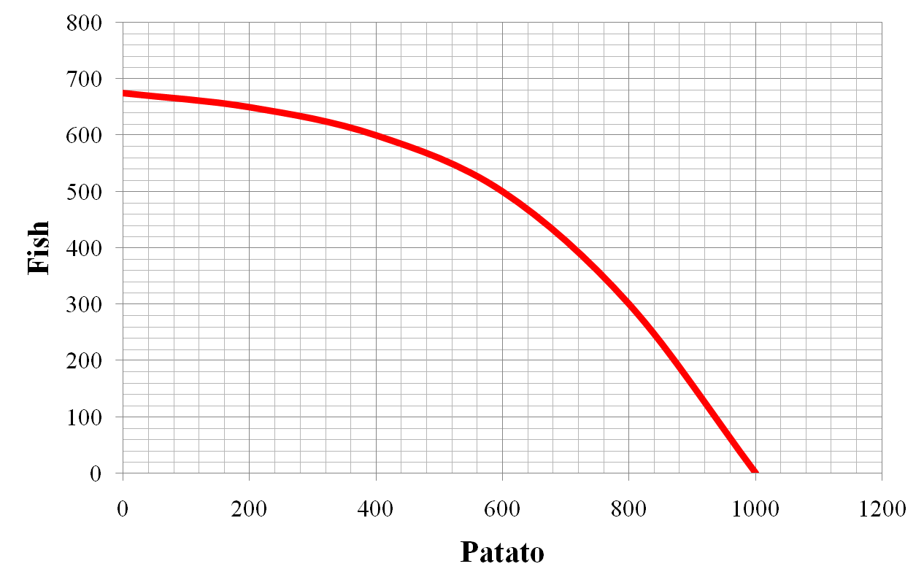
The Shape of the PPF

Slide 27
Why the PPF Might Be Bow-Shaped
As the economy shifts resources
from computer to car:
  PPF becomes steeper
  Opportunity cost per unit of car increases
Computer
Car

Slide 28
Why the PPF Might Be Bow-Shaped
Each unit of resource (labour in this case) is not a perfect substitute to other unit.
At point A, most workers are producing computer,
even though they are better suited to produce cars.
So, the economy do not have to give up much computer to get more cars.
At A, opp. cost of car is low.
A
Computer
Car

Slide 29
Why the PPF Might Be Bow-Shaped
At B, most workers are producing cars.
The few left in computers are the best producers of computer.
Producing more cars would require shifting some of the best labourers away from production computers,
would cause a big drop in computer production
At B, opp. cost of car
is high.
Computer
B
Car

Slide 30
Why the PPF Might Be Bow-Shaped
So, PPF is bow-shaped when different workers have different skills, different opportunity costs of producing one good in terms of the other.
The PPF would also be bow-shaped when there is some other resource, or mix of resources with varying opportunity costs
(e.g., different types of land suited for
different uses).

Slide 31
Our Second Model:
Production Possibilities Frontier
Concepts Illustrated by the Production Possibilities Frontier
  Efficiency
  Tradeoffs
  Opportunity Cost
  Economic Growth
Notes:
21

Slide 32
Shifting the Production Possibilities Curve
4 Key Assumptions Revisited
Only two goods can be produced
Full employment of resources
Fixed Resources
Fixed Technology
What will happen if there is a change?
2 Shifters of the PPC
1. Change in resource quantity or quality
2. Change in Technology
Relaxing
Copyright©2003 Southwestern/Thomson Learning

Slide 33
PPF Example
0
Employment of
labor hours
Production
Cars
Computers
Cars
Computers
A
70,000
0
700
0
B
56,000
14,000
560
1,400
C
35,000
35,000
350
3,500
D
14,000
56,000
140
5,600
E
0
70,000
0
7,000
Each point represents a specific combination of goods that can be produced given full employment of resources (70,000 lab. Hours)

Slide 34
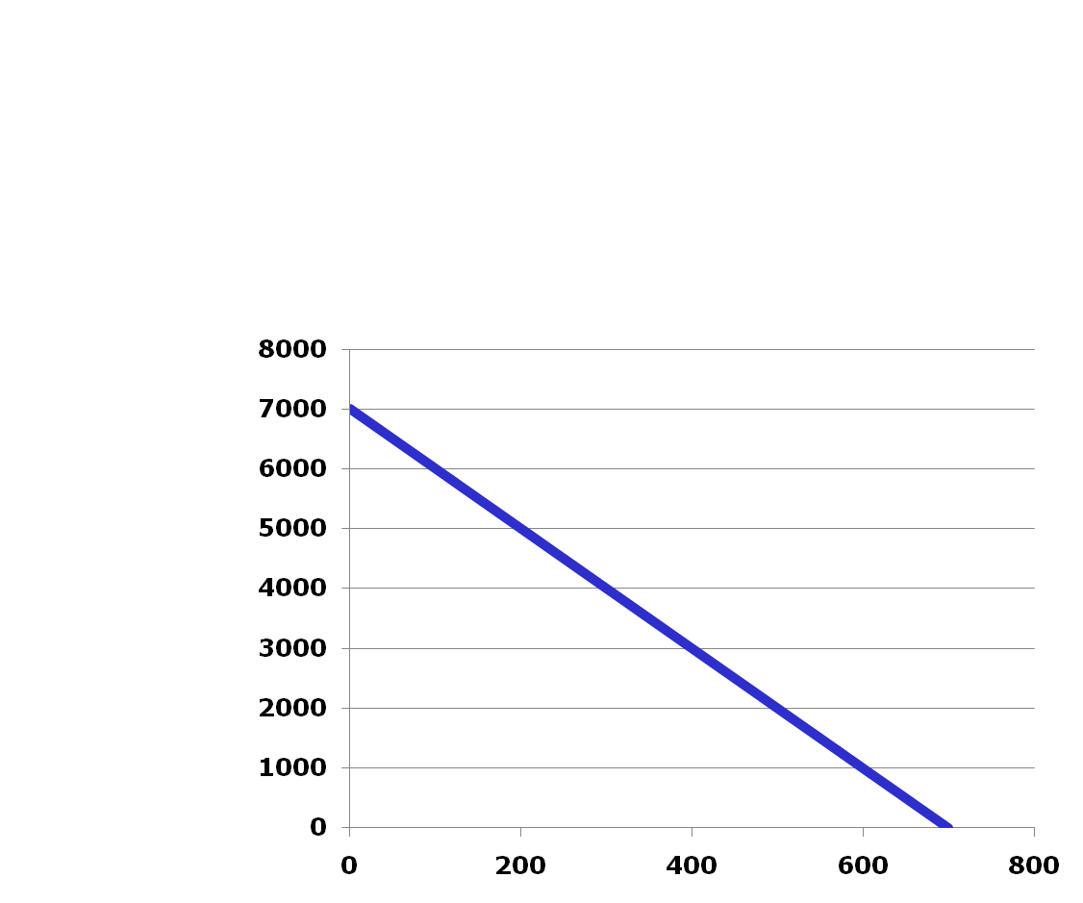
The Production Possibilities Frontier – Change in Resources
Computers
Increase in Resources
Labour hours from
50,000 to 70,000 lab. Hours)
Cars

Slide 35

The Production Possibilities Frontier – Change in Resources
Decrease in Resources
Computers
Cars

Slide 36
The Production Possibilities Frontier – Change in Technology
Computers
Advancement in Technology in Production of Computers
Cars

Slide 37
The Production Possibilities Frontier – Change in Technology
Computers
Advancement in Technology in Production of Cars
Cars

Slide 38
The Production Possibilities Frontier – Economic Growth
Most commonly, growth is defined as an increase in the output that an economy produces over a period of time.
Producing more of one commodity without sacrificing the other, (Movement form point A to B or D) or
Producing more of two commodities. (Movement form point A to C or E)
B
E
C
Computers (No)
D
A
Cars (No)

Slide 39
The Production Possibilities Frontier – Economic Growth
Long-run Economic Growth:
The economy can increase its capacity to produce more by enhancing either its resources or technology or both. This can only be possible in the long-run and not in short-run.
Movement form point B, or C or D to point E indicates long-run economic growth.
In this case, PPF shifts outward or to the right.
B
E
C
Computers (No)
D
Cars (No)

Slide 40
The Production Possibilities Frontier – Economic Growth
Short-run Economic Growth:
In the short-run, it is not possible either to enhance resources or the level of technology.
But, at time economy may not be able to utilise all its available resources, i.e., producing in- efficiently (point A in the diagram).
B
C
Computers (No)
D
A
Cars (No)
The economy may efficiently utilise all its available resources and can produce more by moving to any point on PPF (Point B,C or D in the diagram). There is more production of one commodity without decreasing the production of other or more production of both the commodities. This is short-run economic growth.

Slide 41
The Production Possibilities Frontier – Home Work - I
Surizon, a small country, wants to produce two commodities, say shirt and watch by utilising 1000 labour hours available with it. Various alternatives of production of shirt and watch are given the following table.
Production Alternatives | A | B | C | D | E
Watches (No) | 0 | 30 | 50 | 75 | 100
Shirts (No) | 500 | 350 | 250 | 125 | 0
Utilising the information given in the above table, draw a production possibilities frontier (PPF)?
Compute the opportunity cost per unit of production of watch at each production alternatives given in the above table. Do you find any relationship between the opportunity costs per unit you derive and the production possibilities curve drawn at (a) above? If yes, explain.
Assume that there is an improvement in technology for production of watch. Analyse this situation with the help of the PPF
Assume 500 labour hours reduce from the economy due to migration of the labours. Analyse this situation with the help of PPF .

Slide 42
The Production Possibilities Frontier – Home Work -II
A country produces goods X and Y with the available resources 2500kg of fixed raw material and given technology and has the following equation for its production possibilities frontier:
10Y + X² = 2500
If the country wants to produce 0, 10, 20, 30, 40, and 50 units of X, then how many units of Y will the country is able to produce at each level of production of X.
Graph the information derived at (a) above. What shape the above production possibilities frontier will take?
Calculate the opportunity cost per unit of good X and good Y and explain the behaviour of the opportunity cost of good X.
Explain why the opportunity cost per unit is behaving in this way.
Analyse the relationship between opportunity cost per unit and the shape of PPF.
What will happen to the production possibilities frontier if an improved method of production is being developed which favours production of both X and Y? Analyse with the help of diagram drawn at (b) above.

